Slide 1
Aadhar Card Management System
K23HC
NIMBA SUMEETH SINGH​

Slide 2


Agenda
A
Introduction
System Overview
System Architecture
Non-Functional Requirements
Summary

Slide 3
Introduction
The Aadhar Card Management System is a crucial component of India's national identity infrastructure, aiming to efficiently manage the issuance, updating, and verification of Aadhar cards for citizens.
This project encompasses the design and implementation of a robust system capable of securely handling Aadhar card-related operations, ensuring data integrity, confidentiality, and accessibility.

Slide 4
Purpose Of The SRS
This document is to clearly outline the functional and non-functional requirements of the Aadhar Card Management System, serving as a comprehensive guide for system design, development, and testing.

Slide 5
System Overview
Aadhar Card Issuance:
Facilitates the registration and issuance of Aadhar cards to eligible individuals.
Captures demographic and biometric information for indentity verification.
Aadhar Card Update:
Allows citizens to update their Aadhar card details such as address, phone number, etc..,

Slide 6
Aadhar Card Verification:
Provides a secure mechanism for verifying Aadhar card details.
Enables authentication of individuals for various services and transactions.
Data Security and Privacy:
Implements robust security measures to safeguard sensitive Aadhar card data.
Adheres to government regulations and standards to ensure data privacy and confidentiality.
Target Users:
The Aadhar Card Management System caters to a diverse range of users, including:
  Citizens applying for new Aadhar cards or updating existing ones.
  Enrollment agencies responsible for data collection.
  Government agencies and authorized entities performing Aadhar card verification.

Slide 7
System Architecture
Client Interface:
  Provides user interfaces for citizens to apply for new Aadhar cards, update their information, and verify Aadhar details.
  Supports various channels such as web portals, mobile applications, and enrollment centers.
Application Layer:
  Contains the core business logic and application services responsible for processing Aadhar card-related operations.
  Implements functionalities such as data validation, encryption, and communication with external systems.

Slide 8
Database Layer:
  Stores Aadhar card data, including demographic information, biometric data, and authentication records.
  Utilizes a relational database management system (RDBMS) or NoSQL database for efficient data storage and retrieval.
Security Layer:
  Enforces security measures to protect Aadhar card data from unauthorized access, tampering, or misuse.
  Includes authentication mechanisms, access controls, encryption techniques, and audit trails to ensure data confidentiality and integrity.
Deployment:
The Aadhar Card Management System can be deployed on-premises or in the cloud, depending on organizational requirements and scalability needs.

Slide 9
Non-Functional Requirement
Response Time: The system should respond to user actions within 3 seconds under normal load conditions.
Data Encryption: All communication between the client and server should be encrypted using industry-standard encryption algorithms.
Fault Tolerance: The system should be resilient to failures, with mechanisms in place to recover gracefully in the event of hardware or software failures.
Accessibility: The system should comply with accessibility standards (e.g., WCAG) to ensure that users with disabilities can access and use Aadhar card-related services without barriers.

Slide 10
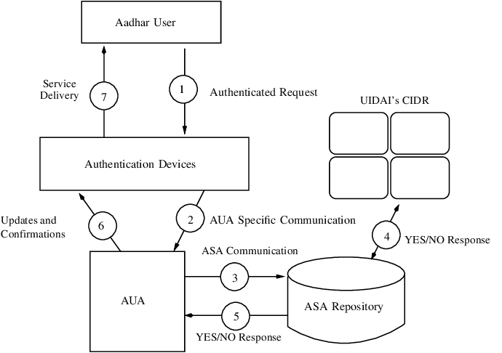
FLOW CHART

Slide 11
Summary
Collaborate closely with stakeholders, development teams, and end-users to ensure alignment with project objectives and user needs throughout the project lifecycle.
Regularly review and update the SRS document as needed to reflect any changes or enhancements to the system requirements based on evolving business requirements or feedback from stakeholders.

Slide 12
Thank you
NIMBA SUMEETH SINGH
LOVELY PROFESSIONAL UNIVERSITY

